Slide 1
How would you go about…. Teaching pigeons how to play ping-pong?

Slide 2
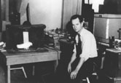
How Do We Learn?
Part II: Operant Conditioning
http://www.bfskinner.org/images.asp

Slide 3
Operant Conditioning
Actions and behavior are learned and controlled by their consequences
Reinforcement or punishment

Slide 4
Reinforcement
Any reward or incentive that strengthens behavior
The Law of Effect: Organisms repeat responses that are followed by favorable outcomes
When is a reward MOST effective? When it:
occurs during or immediately after the behavior (proper timing)
increases the likelihood of the behavior occurring (strong and desirable)

Slide 5
Shaping
Gradual, systematic reinforcement the closer a person or animal gets to a desired behavior.
Shaping demonstration
Practical examples of shaping for humans?
Reduce phobias, teaching young children to write, athletic skills

Slide 6
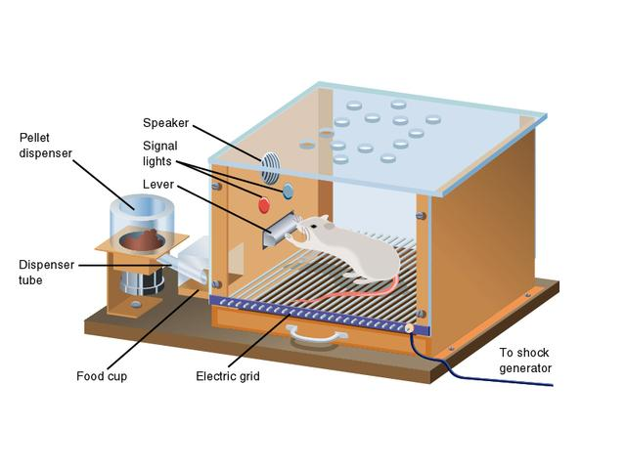
Skinner Box
http://www.mhhe.com/socscience/intro/ibank/ibank/0081.jpg

Slide 7
Types of Reinforcement
positive reinforcement – addition of a desired consequence in order to strengthen behavior
negative reinforcement – removal or prevention of an unwanted consequence in order to strengthen behavior
Avoidance versus escape
How can we reinforce bad behavior?

Slide 8
Punishment
Addition of an unwanted stimulus (or removal of a desired stimulus) in order to weaken unwanted behavior
Positive and negative
When is punishment effective? Ineffective?
Notes:
Although there may be some justification for occasional punishment (Larzelaere & Baumrind, 2002), it usually leads to negative effects.
Punishment can result in unwanted fears.
Conveys no information to the organism.
Justifies pain to others.
Unwanted behaviors reappear in its absence.
Aggression towards the agent.
One unwanted behavior appears in place of another.

Slide 9
Operant Conditioning
So far, we have studied the types of reinforcement
But, HOW and WHEN should effective reinforcements be delivered?
How do we use operant conditioning to “shape” someone’s behavior?
If you wanted your puppy to learn to “fetch” the newspaper, how would you do it?
How do casinos “shape” people into avid gamblers?

Slide 10
Resistance to Extinction
Resistance to Extinction: How long the behavior continues after the reinforcement has been taken away
High resistance to extinction means the behavior continues even though you are no longer reinforced
Low resistance to extinction means the behavior stops relatively soon after the reinforcement stops

Slide 11
Extinction
When is high resistance to extinction desirable?
Casinos want people to gamble but not reward them often
When is low resistance to extinction desirable?
You want a baby’s crying to stop soon after parents no longer come to the room at bedtime

Slide 12
Schedules of Reinforcement
In the real world, reinforcement happens at various and sometimes unpredictable times
Continuous reinforcement: every instance of a certain behavior is reinforced
Intermittent (partial) reinforcement: behavior is reinforced only some of the time
Which is more resistant to extinction?
Intermittent! Why?

Slide 13
Ratio Schedules
Require people to perform a certain
number of behaviors in order to receive reinforcement
fixed-ratio (FR) schedule – reinforcer given after a set, predictable number of behaviors
Sales person receives bonus every 4 sales
variable-ratio (VR) schedule – reinforcer given after unpredictable or “on average” number of behaviors
slot-machines pay off every 6th try on average

Slide 14
Interval Schedules
Reinforcement comes after a certain
amount of time
fixed-interval (FI) schedule – Reinforces a behavior only after a predictable amount of time has elapsed
preparing for an exam only when the exam draws close
variable-interval (VI) schedule – Reinforces a behavior at unpredictable times
dialing a busy phone number

Slide 15
Schedules of Intermittent Reinforcement: HW Review
For each situation:
Identify the reinforcement or reward
Is the reinforcement a ratio schedule or interval schedule?
Is the reward based on a number of behaviors that must be completed? (Ratio)
Is the reward based on a length of time? (Interval)
Decide whether the schedule is fixed or variable
Fixed schedules are predictable and pre-set
Variable schedules are unpredictable and random (“on average”)

Slide 16
Rocky, the Lab Rat Simulation
Think about the four schedules of reinforcement…
How does each schedule generate a different:
Rate of response?
Resistance to extinction?

Slide 17
Schedules of Reinforcement and Rate of Response
If you wanted someone to behave (or perform an action) as quickly as possible, which schedules would you use?
Highest rate of response: fixed ratio and variable ratio
Behaviors that receive VR reinforcement more resistant to extinction

Slide 18
Schedules of Reinforcement and Rate of Response
If you wanted someone to behave consistently over a long period of time, which schedules would you use?
Interval schedules
Behaviors rewarded by FI reinforcers increase around the predictable reward time
Studying for tests
VI reinforcements lead to lower, but very consistent, rates of response over time
Your boss checks your work “periodically”

Slide 19
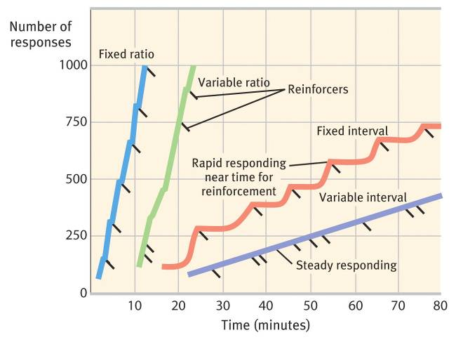
Rate of Response: Schedules of Reinforcement

Slide 20
Learning Unit Wrap-up
The Judge Rotenberg Center

